Slide 1


Practical Statistics
Turning statistics into a toolkit for ecologists

Slide 2




Intro
Henry Häkkinen
Post-Doc studying the effects of climate change on seabirds and how to plan effective conservation. Latterly branched out into impacts of renewable energy on biodiversity.

Slide 3
Optional: Bayesian Statistics
Overview of session:
What is “Bayesian” statistics?
Bayesian versus Frequentist statistics
Bayes’ Theorem
Priors
Running an interative model
Posterior distribution
Interpreting output
Major differences between frequentist and Bayesian model

Slide 4
Cut?: What are statistics?
The collection, organization, analysis, interpretation, and presentation of data
In science, we often use “statistics” as short-hand for “inferential statistics” which examines properties of data in relation to underlying probability distributions
This includes hypothesis testing! And most forms of classical models!
Alternatives include “descriptive statistics” which we use all the time (mean, median, standard deviation etc.)
In inferential statistics we attempt to quantify any patterns in our data, and just as importantly, the uncertainty around those conclusions.

Slide 5
What is a “Bayesian” approach?
An alternative type of statistical inference than that of frequentist statistics.
https://esajournals.onlinelibrary.wiley.com/doi/10.1890/14-0661.1
https://tobiasroth.github.io/BDAEcology/basics.html
https://besjournals.onlinelibrary.wiley.com/doi/10.1111/2041-210X.13407

Slide 6
Wait, what are frequentist statistics?
Probably most, if not all, statistical tests you have done up until this point:
T-tests, linear models, GLMs, GLMMs etc.
Quick test: if it has a p-value it’s probably frequentist
In a frequentist approach we assume there is an overall global distribution, from which our data are just samples
E.g. normal, binomial, Poisson etc.
Frequentist statistics assess:
Whether the data fits our assumed distribution
Whether our data differs from a “null” distribution for hypothesis testing

Slide 7
Side note:
Broadly speaking there are four branches of statistical inference you are likely to come across
Inferential Statistics
Frequentist Statistics
Bayesian Statistics
Likelihood
Information Criteria
Common uses:
Maximum Likelihood Estimation
Likelihood-ratio tests (model comparison)
Common uses:
Aikake Information Criterion (AIC)
Relative model quality and model selection
Some approaches combine these!

Slide 8
What is a “Bayesian” approach?
Definition

Slide 9
Part 1: The Basics of Bayes

Slide 10
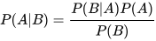
Bayes’ Theorem
The Bayes theorem describes the probability of event A conditional on event B (the probability of A after B has already occurred).
This is calculated using the probability of B conditional on A (what are the conditions of B that A occurs under) and the two separate probabilities of the events A and B.
A simple example: What is the probability that a patient has a disease given that they tested positive for that disease?
P(A|B) is the probability that they have the disease, given that they tested positive
P(B) is the probability that someone tests positive, whether or not they have the disease
P(A) is the probability they actually have the disease (the overall incidence rate of a disease in the population).

Slide 11
Bayes’ Theorem
The Bayes’ theorem in practice:
“The serum test screens pregnant women for babies with Down’s syndrome. The test is a very good one, but not perfect. Roughly 1% of babies have Down’s syndrome. If the baby has Down’s syndrome, there is a 90% chance that the result will be positive. If the baby is unaffected, there is still a 1% chance that the result will be positive. A pregnant woman has been tested and the result is positive.”
What is the chance that her baby actually has Down’s syndrome?
48%! This is non-intuitive, but the knowledge of the general probability of prevalence has revealed some interesting information!

Slide 12
Bayes’ Theorem
This can be difficult to get your head around!
The important thing is this: we inform our probability estimate with prior information about the system
in this case how likely is a test to be correct AND how common is the diseases in the general population

Slide 13
Part 2: running a basic Bayesian model
Using prior information to inform out understanding of the data

Slide 14

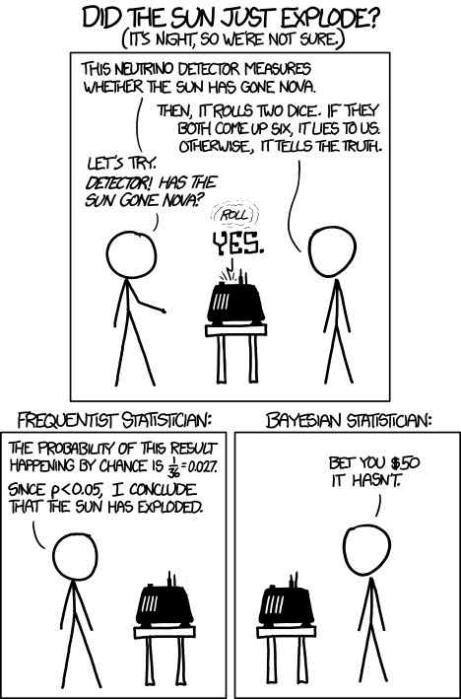
Bayesian Statistics
The basic process for making a Bayesian model works like this:
define the model
define the priors
run the model
check model ran properly (convergence, fuzzy caterpillars etc)
check parameter output
make conclusions and plots
https://xkcd.com/1132/

Slide 15
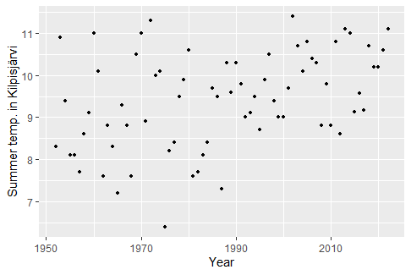
Example Data
A weather station in Kilpisjarvi (Finnish Lapland) has collected average summer temperature since 1954. We will analyse whether it has significantly changed over that period, and whether it has increased

Slide 16
Define the model
This follows many of the steps that we would use in any statistical test! These may include:
Check your data for errors or large outliers! Plot all predictors as histograms, plot against your response variable
Make exploratory plots. Think about what you might expect your answer to look like. Are there obvious relationships? Are they positive or negative?
Sketch your model. Where might there be interactions or non-linear effects?
What kind of distribution does your response variable have? Is it binomial, continuous, count, survival, nominal etc.?
Look at your explanatory variables, is there heavy skew, bimodal distributions or anything that might need to be accounted for?
Are there any data structures that need to be included? Are observations independent or grouped? Are random or phylogenetic effects needed?

Slide 17
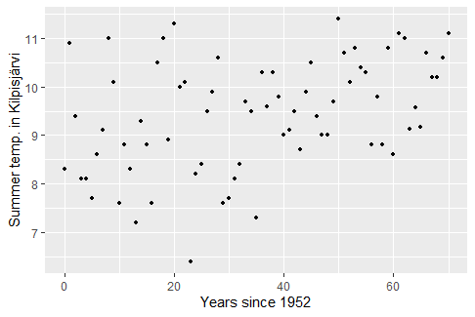
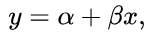
Define the model
This looks linear to me! I could use a normal linear regression with a frequentist approach, but I’ve decided to use a Bayesian approach.
What does a linear model look like?
y ~ a(x) + b ->
b is the intercept
a is the slope of the line

Slide 18
Build and run the model
Now we need to build our model in R!
Side note: There are several packages in R that can run Bayesian models. They all use the same mathematical approach, but the algorithms and methods used to calculate solutions differ.
Rjags
Rstan
rstanarm
brms
R2OpenBUGS
LaplacesDemon
And probably more….
Some are very technical and require a lot of work to run. Some hide a lot of the Bayesian aspects to make it look more like a standard GLM model. Which you use is up to you, but I really dislike packages that “pretend” they’re frequentist so they look more friendly, I would advise to avoid them
Nearly all major packages are based on stan, which is what we’re going to use.

Slide 19
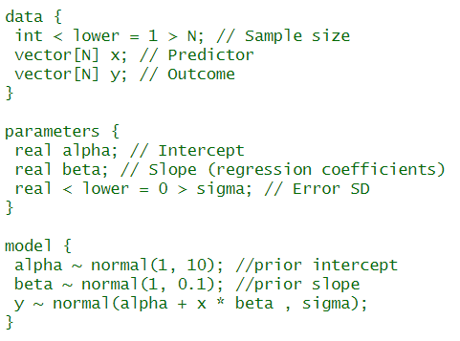
Build and run the model
We are going to use rstan!
It runs C++ in the background, rstan is just the R wrapper on the top
It is extremely fast, powerful and flexible, BUT requires asome knowledge and work to get it to work
Many (if not most) Bayesian packages are based on stan, but are simplified
I will teach using stan, because
All the major principles are the same across packages
It forces you to be specific and to understand all the major components of a Bayesina model
If you understand rstan, then many other packages are very similar, but easier!

Slide 20
Build and run the model
Stan has three parts to a model
Data: we have to state all the relevant parameters, including sample size! WE have to declare what type of data it is.
Parameters: we have to declare all the parameters in the model, and an error term
Model: we have to declare the formula for our model, and our model priors.
For most common models, you can find many examples on line.

Slide 21
Define the priors
Reminder: what is a prior?
Why do we use a prior?
?

Slide 22
Define the priors
We have two parameters, so we need two priors.
What is a reasonable expectation for our intercept (alpha)?
It cannot be below 0 otherwise hard to tell. So we should set a positive prior.
Otherwise it could be anywhere between 6-12 (and probably in the middle)
?

Slide 23
Define the priors
We have two parameters, so we need two priors.
What is a reasonable expectation for our slope (beta)?
We have no expectation on positive or negative slope (null hypothesis is slope is 0), but it could be either
So we set a prior with a centre point of 0, but with the flexibility to move to positive or negative.
But how much flexibility?
?

Slide 24
Define the priors
Is there any relevant information we should incorporate about this system? If this is not a new study system, there may be information about what you expect to see (e.g. mortality rate in a wildlife population can be estimated from previous work)
Alternatively, are there obvious results that we should avoid (e.g. mortality rates cannot be negative)?
If you have absolutely no information or expectations from a system, you can use an uninformative prior (but be careful because if done poorly this can bias results!)
Priors can seem odd at first because they are not objective observations, but subjective decisions. However, they are less subjective than they seem.
And don’t worry, you can make them flexible so if your priors are wrong, then your model can adjust and ignore the priors. Think of priors as a good starting point for your model, not as prescriptive.
Priors make modelling faster as models only trial the parameter estimates we tell it to. They also rule out physically impossible, but mathematically valid, answers. They also can account for uncertainty in observations

Slide 25
How does a Bayesian model actually work?
Bayesian models will take the input data and model and try to estimate the best possible answers and present its results for parameter estimates
How? Through iteration. It will try lots of different combinations of parameters, measure how well these fit the data (through log-likelihood fitting), and report back what it finds. It will use previous results to improve its guesswork going forward. This approach is collectively known as Monte Carlo sampling, of which there are various sub-types.
In total, a Bayesian model will often run tens of thousands of iterations, and will “converge” towards a consensus answer. The answer will never be perfect, but will be very close to the correct answer.

Slide 26
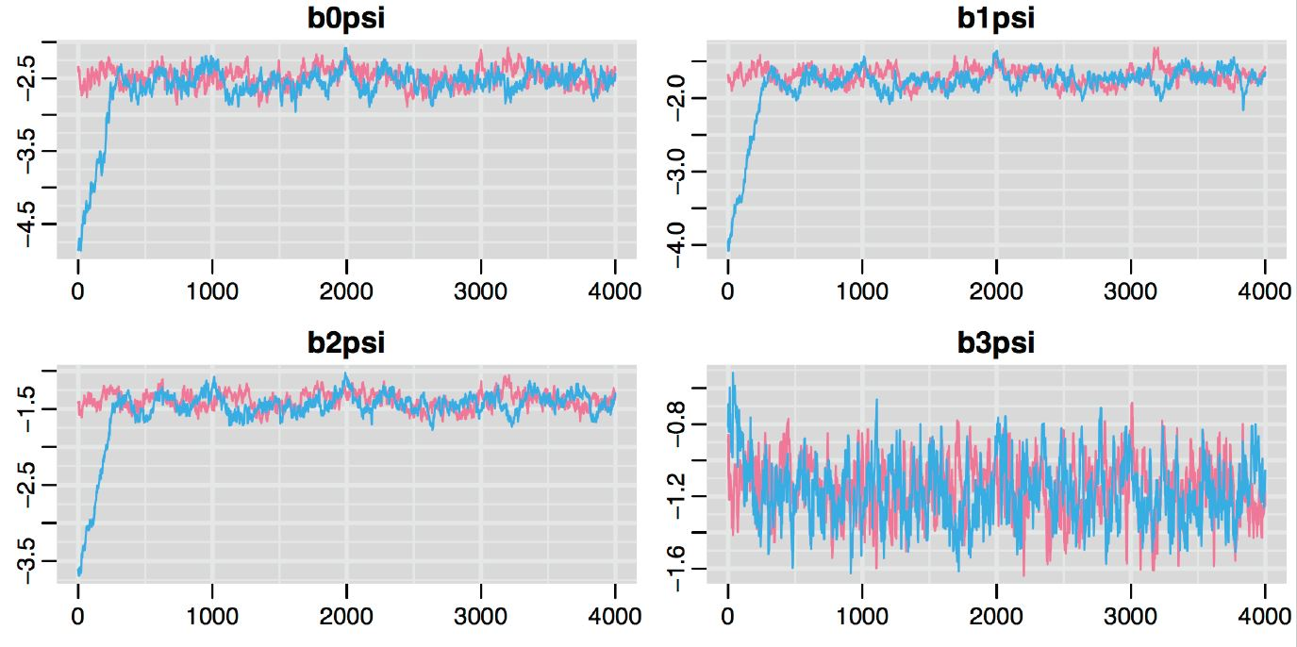
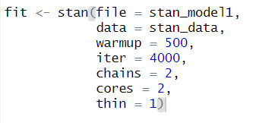

Slide 27
Build and run the model
Model example
Iterative models and chain models
Burn-in
Convergence
Sampling the posterior

Slide 28
Model output
Example of raw model output
Residuals and predictive model checking

Slide 29
Making conclusions

Slide 30
Model comparison
May need several models, can then compare

Slide 31
Which approach should I use?
Both are valid approaches for almost every statistical question, they just work differently
You are run a linear regression using a frequentist or Bayesian approach and they will likely give the same answer.
Advantages of Frequentist approach:
Generally faster, especially for simpler models
Still standard approach in ecology so better tutorials and support
Larger array of tools and packages to solve standard problems, little customisation needed
Results are (often) more interpretable, with single estimates
Advantages of Bayesian approach:
Generally better at modelling complex systems, especially with small sample sizes
Much more powerful and flexible, can solve statistical problems that frequentist approaches cannot
Credible intervals are usually more robust, generally give a more intuitive sense of uncertainty

Slide 32
Part 3: Practical advice

Slide 33
Differences between Frequentist and Bayesian: part 2

Slide 34
Bayesian Statistics
Bayesian statistics use a different approach. There is no null model, there are no p-values, and no residuals (sort of). There is no theoretical “ideal” distribution. Instead, the data is considered to be “reality” and we just see how well we can describe it mathematically.
Bayesian statistics rely heavily on priors. This is information we provide to the model about what we think reality is like
This reliance on “Bayes theorem” is critical. We tell the model what we think reality is like, and then the model find parameters to describe it.
This may seem odd, and subjective, but it is more important and appropriate than you think

Slide 35
The Bayesian Approach: When do I use it?
If it makes sense for your data (heavy conditional probabilities)
If standard frequentist methods don’t work
Lots of random effects?
Highly hierarchical data?
No standard distributions work?
Other problems that can’t be modelled easily in a frequentist approach (e.g. heteroskedasticity)?
If the model you wish to build has too much complexity for the sample size. Bayesian approaches can compensate for small sample sizes to some extent, especially for categories, interactions and other terms that require a large number of degrees of freedom in a frequentist approach
If you like the Bayesian approach and have a lot of time on your hands!
Makes you specify your model and really understand your data
Also takes time and experience to run them!

Slide 37
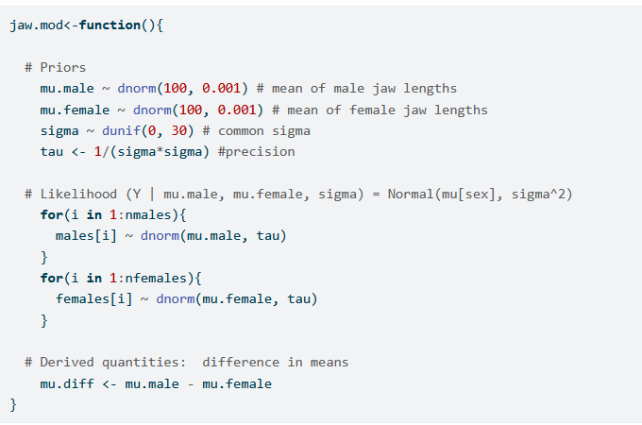
The Bayesian Approach: Example
We are going to compare jaw length in male and female jackals.
This is a normal distribution, that may vary between two categories (male and female)
As it’s a normal distribution it only has two parameters, the mean and the standard deviation
We set the priors to be specific, but with some flexibility to change
Here’s the model:

Slide 38
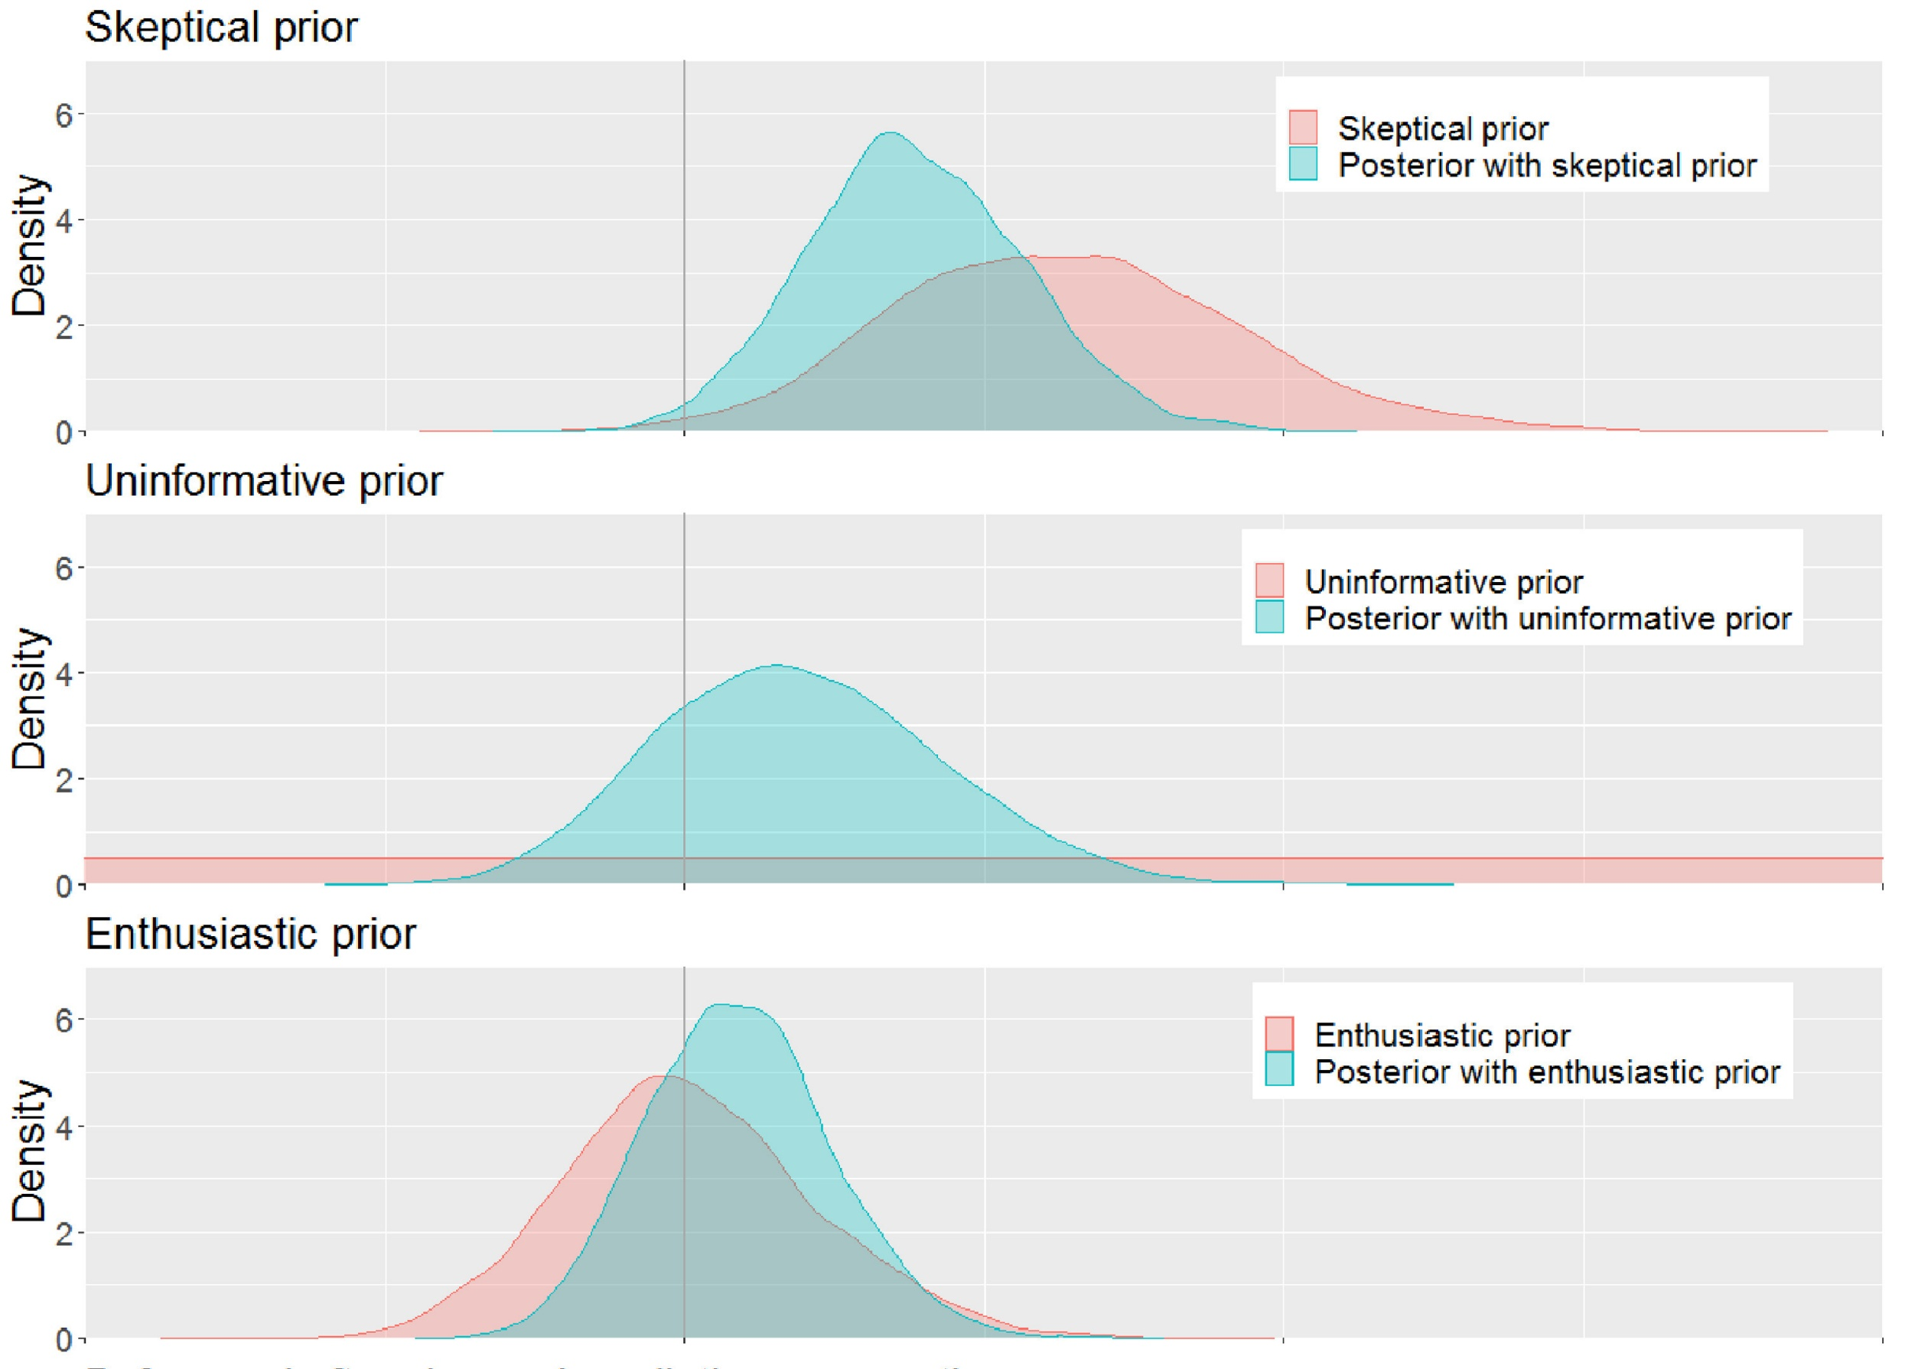
The Bayesian Approach: Example
It is up to us on how restrictive or flexible the priors are
Many are tempted to use an “uninformative” prior, but these often bias models AND make them harder to converge.
https://www.redjournal.org/article/S0360-3016%2821%2903256-9/fulltext

Slide 39
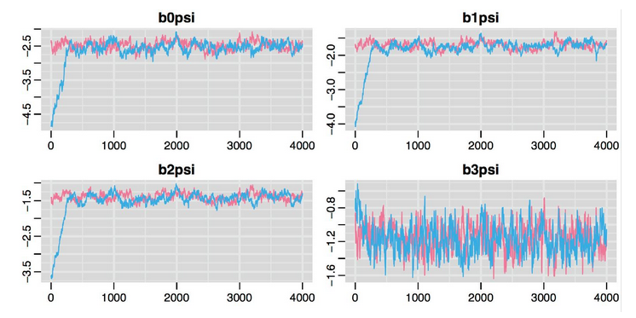
The Bayesian Approach: Example
We run the model and make sure it’s converged. The model will iterate across the parameter space and try out all (or nearly all) possible solutions.
It should resolve to the most likely solutions. This consistency is called “convergence”.
We can check for it by looking for “fuzzy caterpillars”

Slide 40
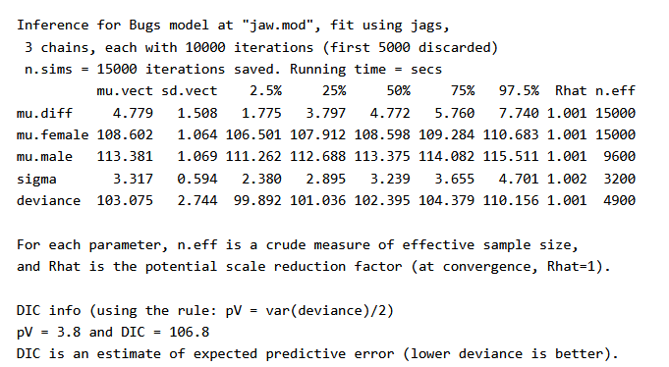
The Bayesian Approach: Example
The output of a Bayesian model will tell us where the parameters are by the end
This output is known as the “posterior” distribution
These are equivalent to parameter estimates in normal GLMs, but intrinsically come with credible intervals.

Slide 41
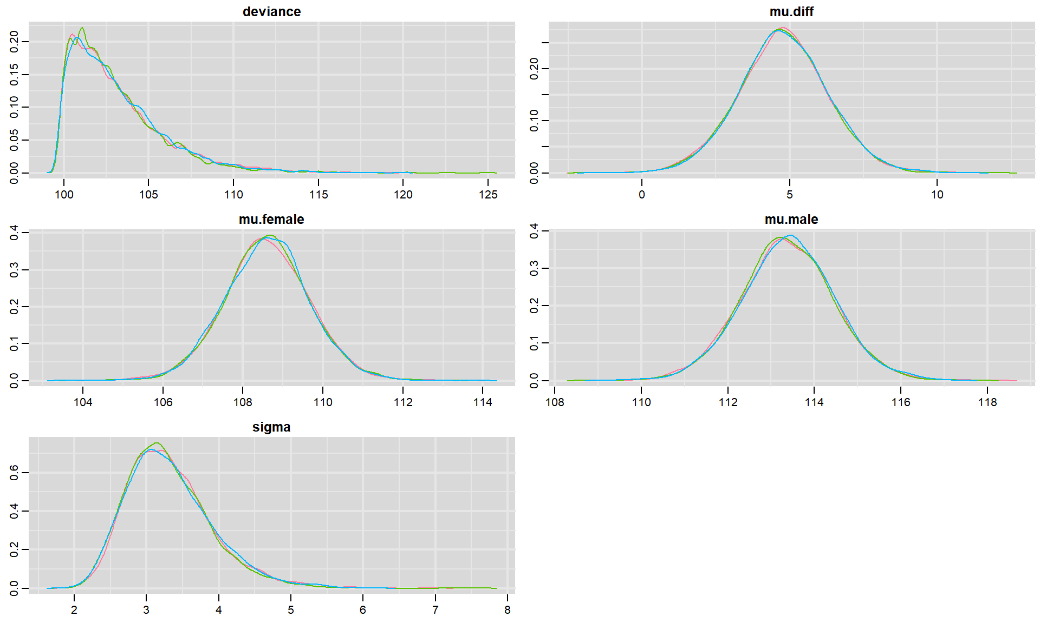
The Bayesian Approach: Example
We can look at these estimates as distributions. Where is the mean estimate, how certain is the model that this is the “real” estimate?

Slide 42
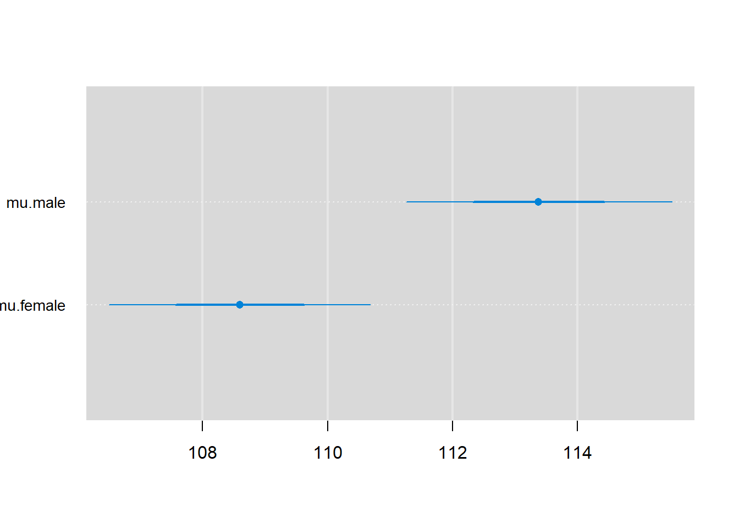
The Bayesian Approach: Example
We use credible intervals to check whether there is any overlaps or substantial differences. For example, is there any overlap in average female and average male jaw size at 90% CI?

Slide 43
Part 4: Exercises

